Slide 1

Agentic AI Hackathon: Building Intelligent Agents with IBM Granite and LangFlow
Project title: AI-Assisted Medication Adherence Monitoring System

Slide 2
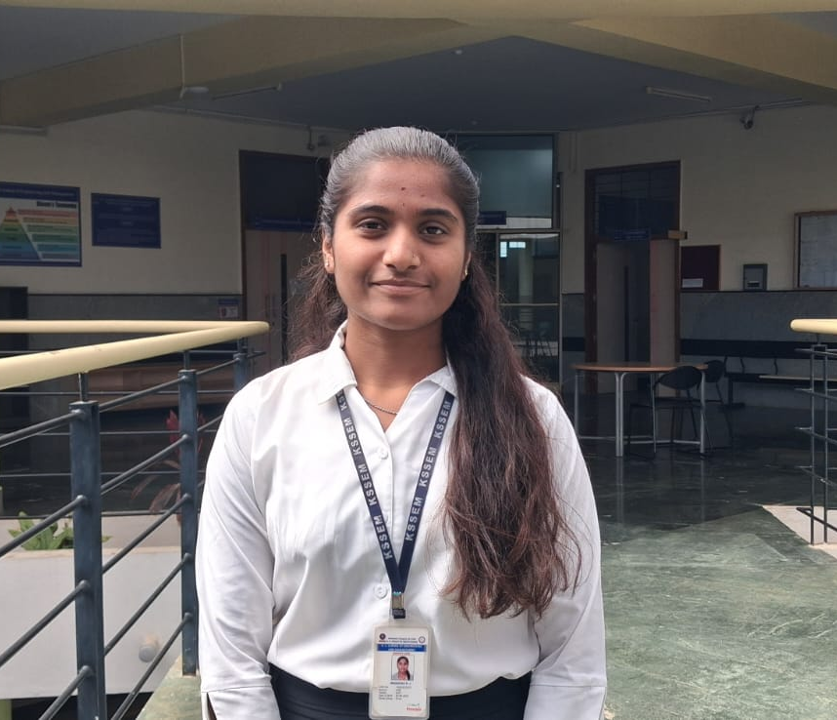
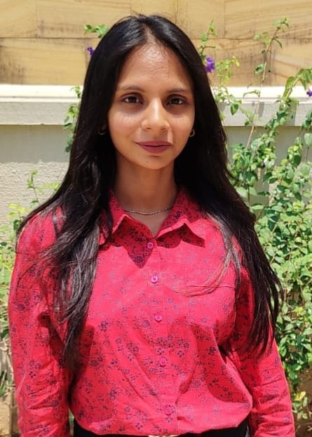
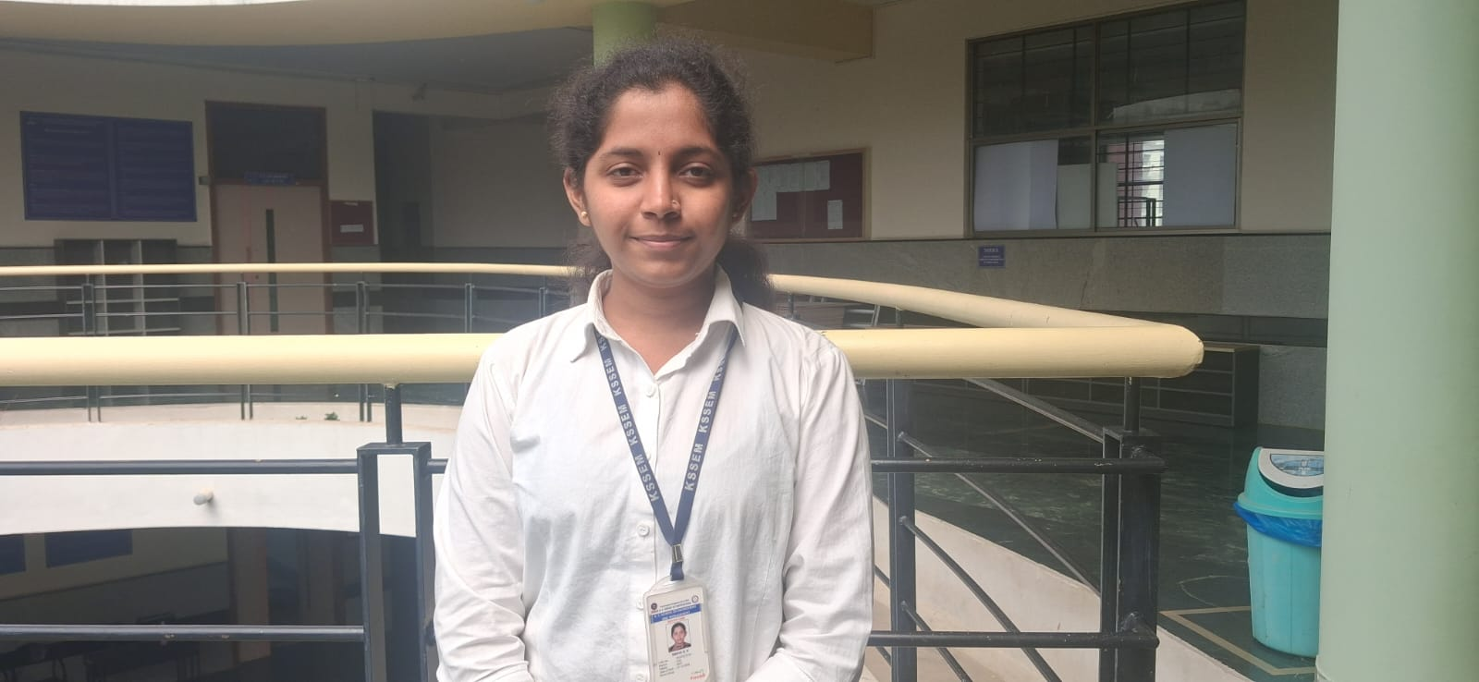
Name of the team: DoseMentor
Details of Team members
TEAM MEMBER NAME | Recent Passport Photo | Email ID | Phone number [WhatsApp]
MEGHANA KJ |  | meghanaprakash2005@gmail.com | +91 80506 02569
RIDA SHARIFF |  | ridsshariff@gmail.com | +91 91130 40878
SNEHA GK |  | snehagkudur@gmail.com | +91 7676915294

Slide 3
Problem statement
AI-Assisted Medication Adherence Monitoring System
The Challenge Medication of non-adherence is a major challenge in chronic disease management, often leading to poor health outcomes and increased hospitalizations. Healthcare providers lack continuous visibility in patient medication adherence patterns. There is a need for an assistive AI system that can analyze adherence data and identify patients at risk of non-compliance.
Medication Data Analysis Agent
An agent that analyzes medication intake logs, refill history, and missed-dose patterns.
Adherence Risk Detection Agent
An agent that identifies declining adherence trends using historical patterns and predefined rules.
Reminder & Lifestyle Support Assistant
An agent that generates adherence to reminders and educational insights (assistive only, non-diagnostic). Outcome Improves medication adherence to awareness and supports better long-term treatment outcomes.

Slide 4
Proposed solution
We propose an AI-Assisted Medication Adherence Monitoring System developed using LangFlow and IBM Granite models to support patients in following their prescribed medication schedules.
The system allows users to describe their medication intake or missed doses using natural language prompts.
An AI agent powered by IBM Granite analyzes the input and extracts structured adherence information such as the medical condition, medication name, and missed-dose frequency.
The extracted data is stored in a centralized database, enabling support for multiple users and continuous adherence tracking over time.
Historical adherence patterns are analyzed to identify early signs of non-compliance.
Based on these insights, the system provides assistive reminders and educational guidance, strictly for awareness and not for medical diagnosis.
Outcome: Enhances patient awareness, encourages consistent medication intake, and supports better long-term treatment outcomes.
.

Slide 5
Need of project
Medication non-adherence is a significant challenge in chronic disease management and is one of the leading causes of treatment failure, disease progression, and avoidable hospitalizations.
Patients often miss doses due to factors such as busy lifestyles, forgetfulness, lack of awareness about medication importance, or absence of timely support.
Healthcare systems currently lack continuous, real-time visibility into patient medication-taking behavior outside clinical visits.
Traditional adherence monitoring methods are mostly manual, reactive, and fragmented, making it difficult to identify problems early.
Patients receive limited personalized guidance and reminders, reducing long-term treatment effectiveness.
Early warning signs of non-adherence are often overlooked, resulting in delayed medical intervention and higher healthcare costs.
This project is needed to provide an AI-assisted, scalable solution that can continuously monitor medication adherence, analyze behavioral patterns, and offer assistive reminders and educational insights to improve awareness and support better long-term health outcomes.

Slide 6
End user of project
Patients with chronic conditions such as diabetes or hypertension who require long-term medication adherence support
Caregivers and family members who assist patients in managing daily medication schedules
Healthcare providers who can monitor adherence patterns and identify potential non-compliance risks
Hospitals, clinics, and healthcare organizations aiming to improve treatment outcomes and reduce avoidable hospitalizations

Slide 7
Technology Used
Langflow platform
Langflow component name – Agent , Chat input , Chat output, prompt, Retriever
IBM Grainte model - for eg – ibm-granite-3-2-8b instruct
IBM Cloud
IBM Watsonx.ai
Retrieval Augmented Generation (RAG) – Vector Database + Embeddings
IBM Watsonx Foundation Models

Slide 8
Novelty and Uniqueness
The "Impact" Focus : system features an Automated Clinical Intervention Layer that converts passive database alerts into real-world SMS actions, ensuring 100% patient-reach in critical non-adherence events.
End-to-end AI workflow built visually using Langflow, reducing development complexity and improving explainability.
Exclusive use of IBM watsonx.ai and Granite foundation models, ensuring enterprise-grade, secure, and responsible AI.
Dynamic Retrieval-Augmented Generation (RAG) enables context-aware and accurate responses using real-time and stored data.
Modular agent-based architecture, allowing easy scalability, customization, and future feature expansion.
Seamless integration of multiple AI components (agents, prompts, retrievers) without traditional hard-coded pipelines.

Slide 9
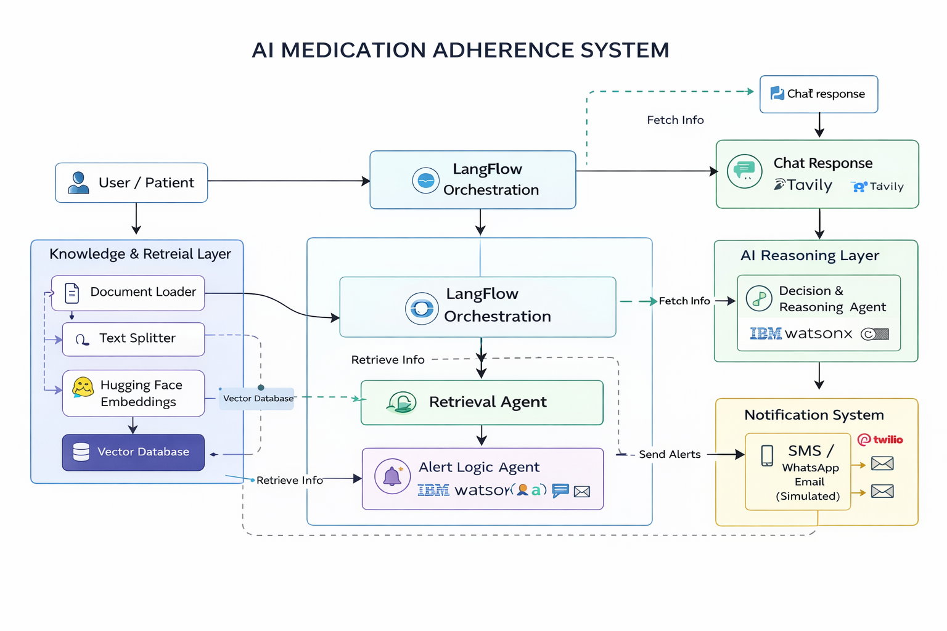
Technical flow diagram - Architecture blueprint

Slide 10
Langflow component Used
Chat Input: Accepts the user’s question or message as the entry point to the flow.
Text Input: Takes additional user-provided text for processing.
System Prompt / Prompt Template: Defines how the AI should behave and format its response.
Agent Instructions: Specifies the task and role the agent must perform.
Document Supervisor Agent: Coordinates document understanding and retrieval tasks.
Agent (Supervisor / Planner): Decides which tools or actions to invoke based on the query.
Hugging Face Embeddings: Converts text data into vector embeddings for similarity search.
Vector Store (FAISS / Vector DB): Stores embeddings to enable semantic retrieval.

Slide 11
Langflow component Used
Retriever: Fetches the most relevant documents based on vector similarity.
Python Interpreter: Executes Python logic for data processing and transformations.
Parser: Converts raw outputs into structured, readable formats.
IBM Watsonx LLM: Generates AI responses using IBM’s foundation models.
Tavily Search API: Retrieves real-time web information to enrich responses.
Embedding Model (Secondary): Creates embeddings for newly retrieved or updated data.
Chat Output: Displays the final AI-generated response to the user.

Slide 12
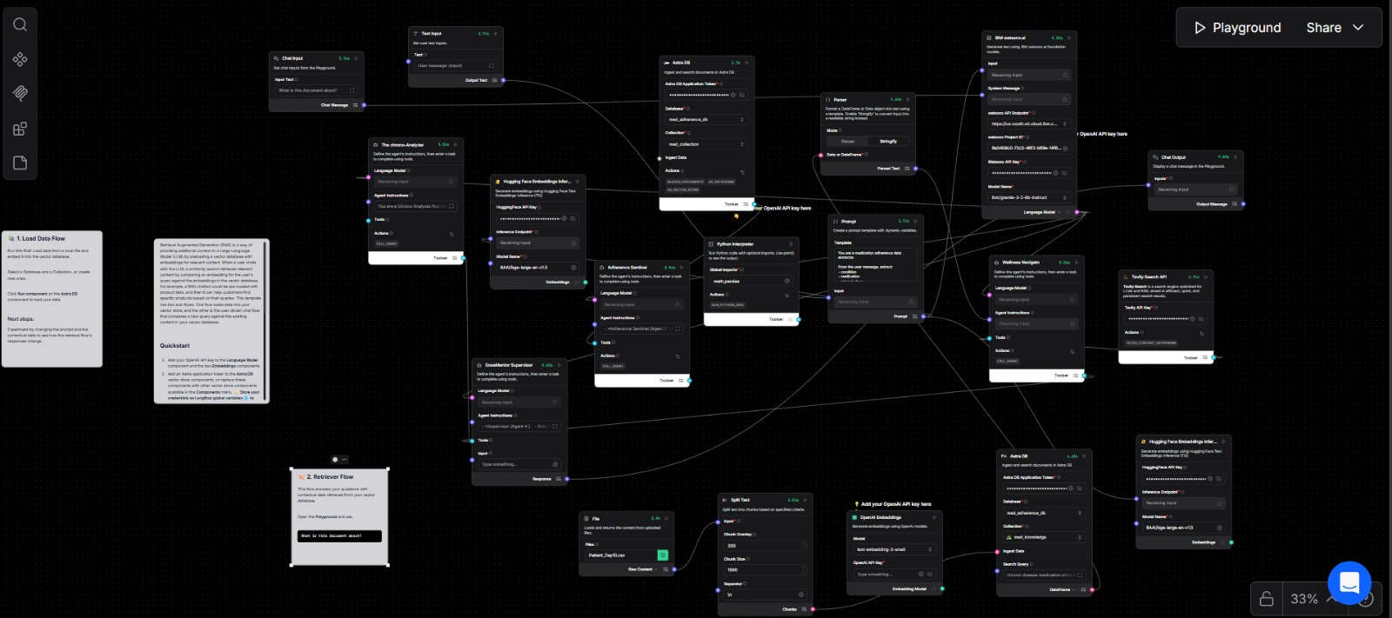
Input Screenshot 1

Slide 13
Future Scope
Real-Time Multi-Channel Alerts Extend reminders beyond SMS to include WhatsApp, mobile app notifications, voice calls, and email for higher adherence.
Prescription-Based Automation Integrate OCR and EHR systems to automatically extract dosage schedules from uploaded medical prescriptions.
AI-Powered Adherence Prediction Use machine learning to predict missed doses based on user behavior and proactively send reminders.
Doctor & Caregiver Dashboard Provide real-time dashboards for doctors and caregivers to monitor patient adherence and intervene early.
Wearable & IoT Integration Connect with smart pill boxes and wearables to auto-detect medication intake.
Multilingual & Accessibility Support Enable voice and text reminders in regional languages for elderly and visually impaired patients.
Scalable Cloud Deployment Deploy the system on cloud infrastructure to support thousands of patients securely and reliably.
Compliance & Security Enhancements Implement healthcare standards like HIPAA/GDPR with end-to-end data encryption.
·
·
·

Slide 14
Git Hub Link
Github URL –https://github.com/meghanakj2005/DoseMentor.git
·
·
·

Slide 15
References
LangFlow Documentation Agent-Based AI Workflow Orchestration https://docs.langflow.org
Hugging Face Pretrained Models & NLP Frameworks https://huggingface.co/docs
Tavily API AI-Powered Search & Retrieval API https://docs.tavily.com
IBM watsonx.ai Foundation Models & AI Services https://www.ibm.com/products/watsonx-ai
·
·
·

Slide 16


